Slide 1
Linear Regression & Gradient Descent
With Quick Review of Math involved
Ramendra Kumar
Reference: http://cs229.stanford.edu

Slide 2
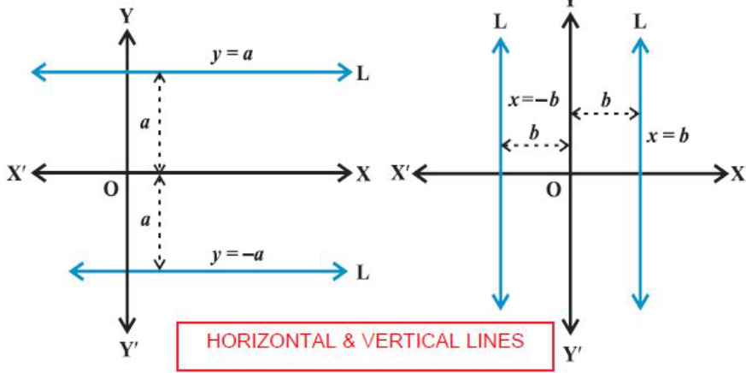
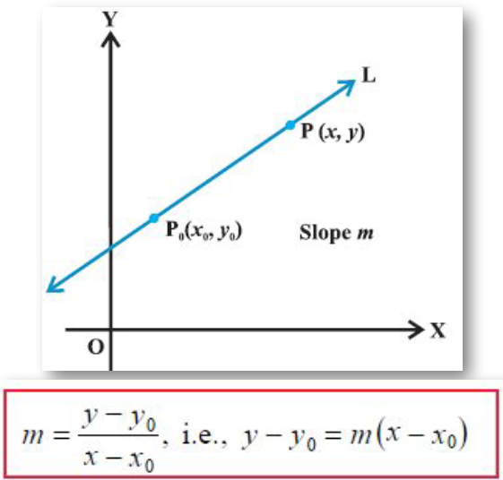
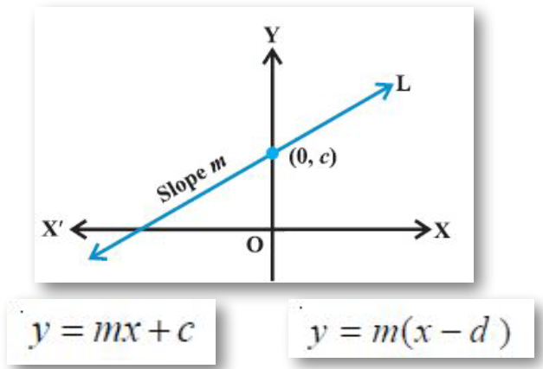
Equations of Straight line
Point Slope Form
θ
Slope Intercept Form
m=tanθ

Slide 3
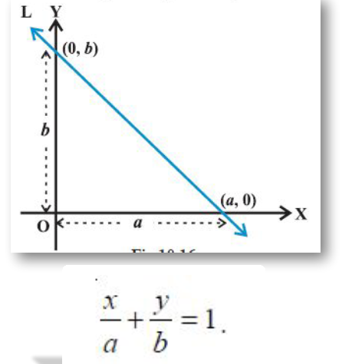
Intercept Form

Slide 4
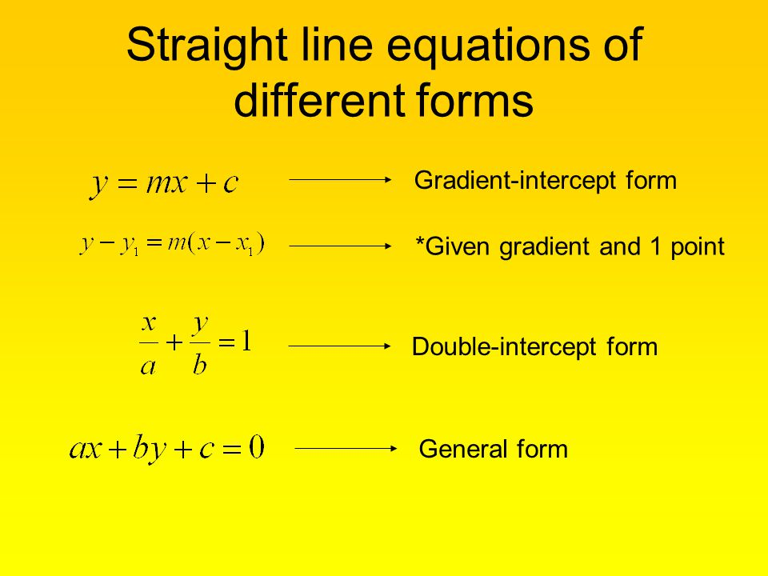
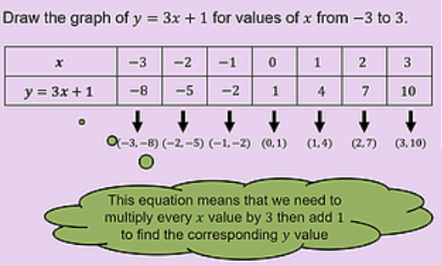










$$⇉ax+by+c_{1}=0$$
3x+4y+8=0
or, $by=−ax+(−c_{1})$
$$or, y=\left(−\frac{a}{b}\right)x +(−\frac{c_{1}}{b})$$
→ $m=\left(−\frac{a}{b}\right) and c=(−\frac{c_{1}}{b}$)
$${⇉a}_{1}x+b_{1}y+c_{1}=0$$
$${or, a}_{1}x+b_{1}y =−c_{1}$$
or, $\left(\frac{a_{1}}{− c_{1}}\right)x +\left(\frac{b_{1}}{− c_{1}}\right)y=1$
or, $\left(\frac{x}{\frac{− c_{1}}{a_{1}}}\right) +\left(\frac{y}{\frac{− c_{1}}{b_{1}}}\right)=1$
→ a$=\frac{− c_{1}}{a_{1}} and b=(−\frac{c_{1}}{b_{1}}$)

Slide 5
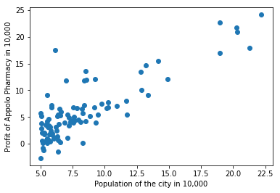
Single Variable Regression
Locations | Population of the city (in ten tho) | Profit ($ in ten thou)
0 | 6.1101 | 17.592
1 | 5.5277 | 9.1302
2 | 8.5186 | 13.662
3 | 7.0032 | 11.854
4 | 5.8598 | 6.8233
5 | 8.3829 | 11.886
6 | 7.4764 | 4.3483
7 | 8.5781 | 12
8 | 6.4862 | 6.5987
9 | 5.0546 | 3.8166
10 | 5.7107 | 3.2522
11 | 14.164 | 15.505
12 | 5.734 | 3.1551
13 | 8.4084 | 7.2258
Profit Population
y = mx + c
Snippet of Data, there may be 13K or more rows.
Multiple lines can be fit to approximate linear relationship
between Population and Profit. Say red one is the best fit line.

Slide 6
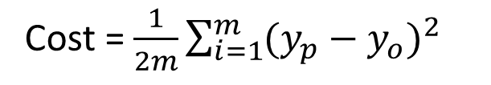
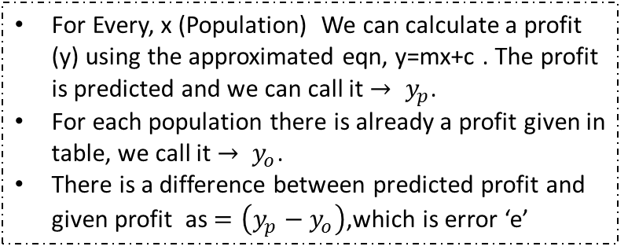

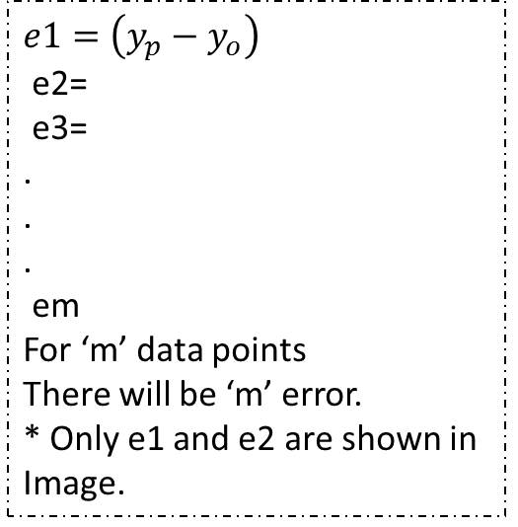
Locations | Population of the city (in ten tho) | Profit ($ in ten thou)
0 | 6.1101 | 17.592
1 | 5.5277 | 9.1302
2 | 8.5186 | 13.662
3 | 7.0032 | 11.854
4 | 5.8598 | 6.8233
5 | 8.3829 | 11.886
6 | 7.4764 | 4.3483
7 | 8.5781 | 12
8 | 6.4862 | 6.5987
9 | 5.0546 | 3.8166
10 | 5.7107 | 3.2522
11 | 14.164 | 15.505
12 | 5.734 | 3.1551
13 | 8.4084 | 7.2258
For Every, x (Population) We can calculate a profit (y) using the approximated eqn, y=mx+c . The profit is predicted and we can call it ${→ y}_{p}$.
For each population there is already a profit given in table, we call it ${→ y}_{o}$.
There is a difference between predicted profit and given profit as $=\left(y_{p}−y_{o}\right)$,which is error ‘e’
Profit Population
y = mx + c
$$y_{p}$$
e2
$$e1=\left(y_{p}−y_{o}\right)$$
e2=
e3=
.
.
.
em
For ‘m’ data points
There will be ‘m’ error.
* Only e1 and e2 are shown in
Image.
e1
Mean of the sum of the
squares of all the Errors (MSE).Here
written as Cost (function).→
Cost = $\frac{1}{2m}\sum_{i=1}^{m}{{(y_{p}−y_{o})}^{2}}$
The line with least Cost, is the best fit line.
We have to find that.

Slide 7
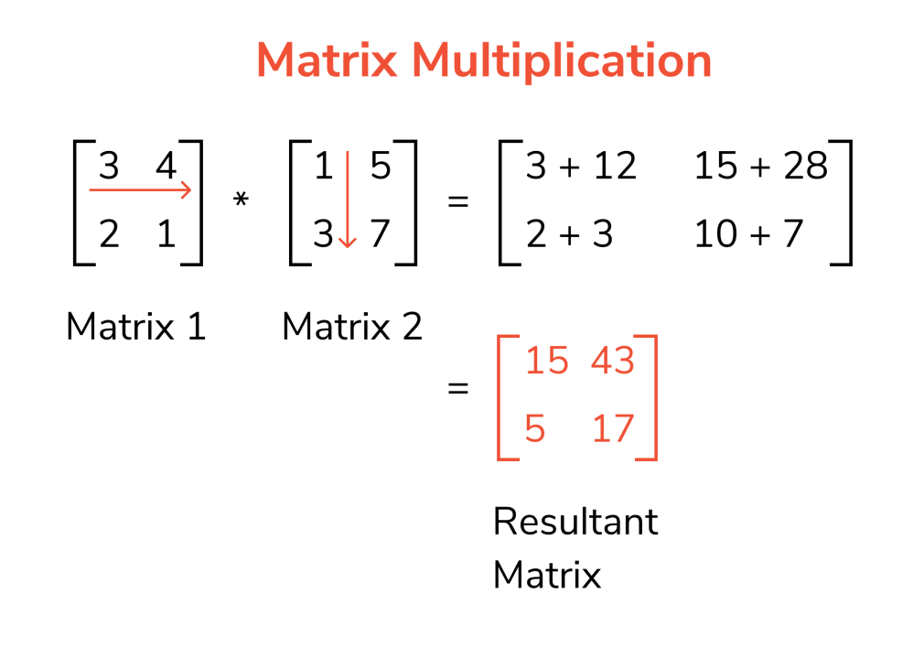
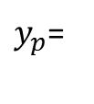










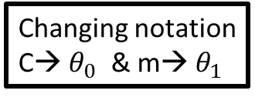
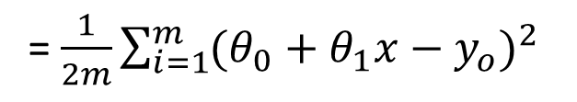


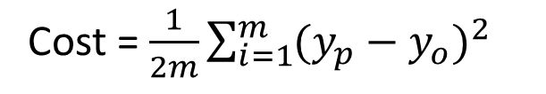

Writing , y=mx+c in Matrix Form
Changing notation
C→$θ_{0}$& m→$θ_{1}$
$$y_{p}=mx+c$$
$$or,y_{p}=θ_{1}x+θ_{0}$$
$$or,y_{p}={θ_{0}+θ}_{1}x$$
or,$y_{p}=θ_{0}.1+θ_{1}.x$
$y_{p}$=
$$\left\lfloor \begin{matrix}1 & x\end{matrix}\right\rfloor$$
*
$$\left\lfloor \begin{matrix}θ_{0} \\ θ_{1}\end{matrix}\right\rfloor$$
$\vec{x}=\left(1,x\right) And$ as a matrix [1 x]
$\vec{θ}=(θ_{0},θ_{1})$ And as a matrix [$θ_{0}θ_{1}$]
Dot product of
$\vec{a}=(a_{1},a_{2}$)= $a_{1}i+a_{2}j$
Vector dot product:
$$\vec{x }.\vec{ θ}$$
$\vec{b}={(b}_{1},b_{2})$= $b_{1}i+b_{2}$j
Substituting in Cost Fn.
Matrix product:
$$xθ^{T}$$
$\vec{a}.\vec{b}=a_{1}$. $b_{1}$+ $a_{2} .b_{2}$
Cost = $\frac{1}{2m}\sum_{i=1}^{m}{{(y_{p}−y_{o})}^{2}}$
= $\frac{1}{2m}\sum_{i=1}^{m}{{(θ_{0}+θ_{1}x−y_{o})}^{2}}$

Slide 8
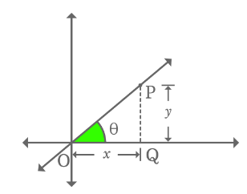
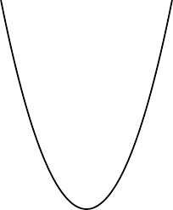

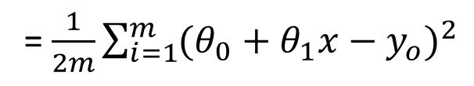
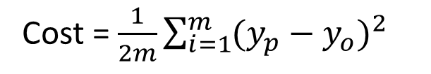
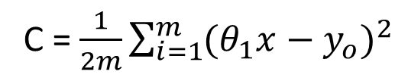
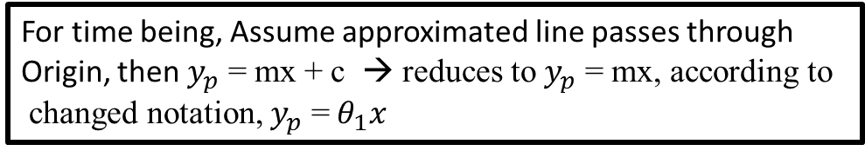
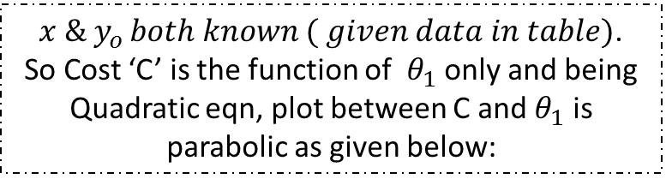

Cost = $\frac{1}{2m}\sum_{i=1}^{m}{{(y_{p}−y_{o})}^{2}}$
For time being, Assume approximated line passes through
Origin, then $y_{p}$ = mx + c → reduces to $y_{p}$ = mx, according to
changed notation, $y_{p}$ =$θ_{1}x$
= $\frac{1}{2m}\sum_{i=1}^{m}{{(θ_{0}+θ_{1}x−y_{o})}^{2}}$
Locations | Population of the city (in ten tho) | Profit ($ in ten thou)
0 | 6.1101 | 17.592
1 | 5.5277 | 9.1302
2 | 8.5186 | 13.662
3 | 7.0032 | 11.854
4 | 5.8598 | 6.8233
5 | 8.3829 | 11.886
6 | 7.4764 | 4.3483
7 | 8.5781 | 12
8 | 6.4862 | 6.5987
9 | 5.0546 | 3.8166
10 | 5.7107 | 3.2522
11 | 14.164 | 15.505
12 | 5.734 | 3.1551
13 | 8.4084 | 7.2258
C = $\frac{1}{2m}\sum_{i=1}^{m}{{(θ_{1}x−y_{o})}^{2}}$
$x \& y_{o }both known ( given data in table)$.
So Cost ‘C’ is the function of $θ_{1}$ only and being
Quadratic eqn, plot between C and $θ_{1}$ is parabolic as given below:
Cost---->
Cmin
$$θ_{b}$$
$θ_{1}$----->

Slide 9
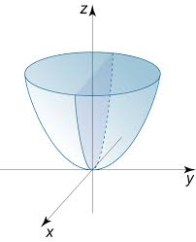

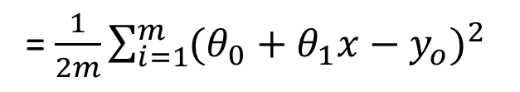

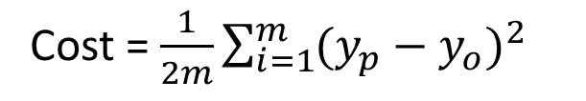


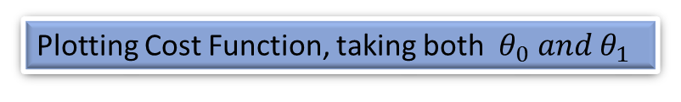

Plotting Cost Function, taking both $θ_{0} and θ_{1}$
Cost = $\frac{1}{2m}\sum_{i=1}^{m}{{(y_{p}−y_{o})}^{2}}$
Cost---->
= $\frac{1}{2m}\sum_{i=1}^{m}{{(θ_{0}+θ_{1}x−y_{o})}^{2}}$
Equation of 3D Paraboloid
$$C_{min}$$
$$θ_{1}^{b}$$
$θ_{1}$----->
$$θ_{0}^{b}$$
$$θ_{0}$$

Slide 10
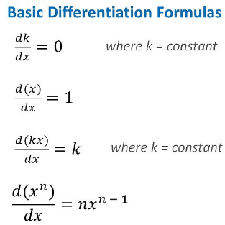
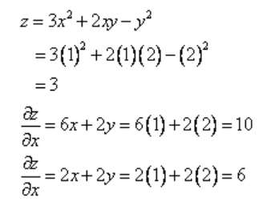
Partial Derivative Example
Given → x=1, y=2
This should be differential with respect to y .
And following calculation is also wrong
try yourself.

Slide 11

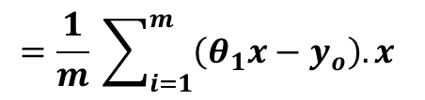
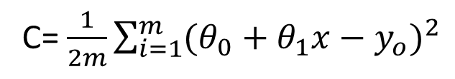
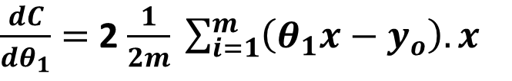



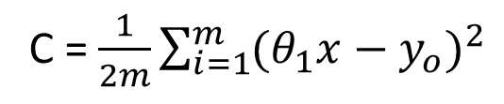

Defining Gradient and Calculating it.
Cost = $\frac{1}{2m}\sum_{i=1}^{m}{{(y_{p}−y_{o})}^{2}}$
C = $\frac{1}{2m} \sum_{i=1}^{m}{{ \left(θ_{1}x−y_{o}\right)}^{2}}$
C= $\frac{1}{2m}\sum_{i=1}^{m}{{(θ_{0}+θ_{1}x−y_{o})}^{2}}$
$$\frac{dC}{dθ_{1}}=\frac{1}{2m} \sum_{i=1}^{m}{ \frac{d{\left(θ_{1}x−y_{o}\right)}^{2}}{d(θ_{1}x−y_{o})} . \frac{d(θ_{1}x−y_{o})}{d(θ_{1})}}$$
When $θ_{0}$ = 0
$\frac{dC}{dθ_{1}}=$ 2 $\frac{1}{2m} \sum_{i=1}^{m}{\left(θ_{1}x−y_{o}\right).x}$
C = $\frac{1}{2m}\sum_{i=1}^{m}{{(θ_{1}x−y_{o})}^{2}}$
$$=\frac{1}{m} \sum_{i=1}^{m}{\left(θ_{1}x−y_{o}\right).x}$$
Gradient →Slope of Tangent at any given point $θ_{1}$on the curve
Cost---->
Cost---->
Cost---->
Cmin
$$θ_{b}$$
$θ_{1}$----->
$$θ_{1}^{a}{ θ}_{1}^{b} θ_{1}^{c}$$
$θ_{1}$----->
$$θ_{1}^{d}{ θ}_{1}^{e} θ_{1}^{f}$$
$θ_{1}$----->

Slide 12
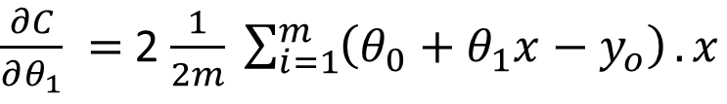
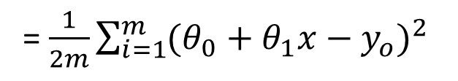
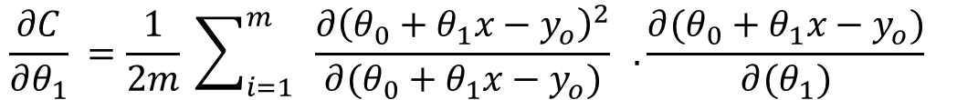
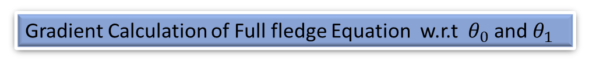
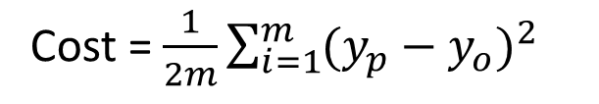
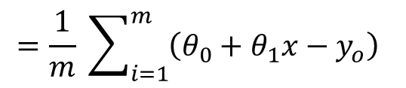
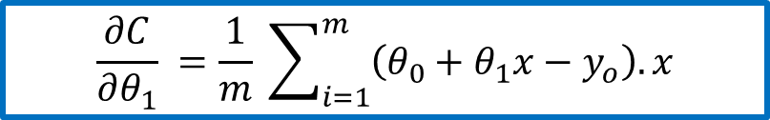
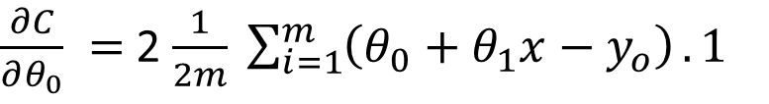

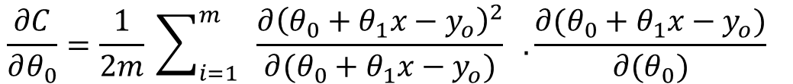
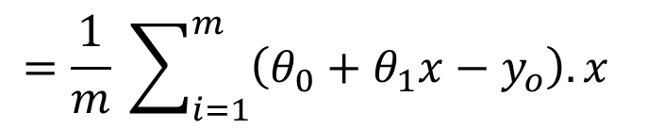
Gradient Calculation of Full fledge Equation w.r.t $θ_{0}$ and $θ_{1}$
Cost = $\frac{1}{2m}\sum_{i=1}^{m}{{(y_{p}−y_{o})}^{2}}$
= $\frac{1}{2m}\sum_{i=1}^{m}{{(θ_{0}+θ_{1}x−y_{o})}^{2}}$
$$\frac{∂C}{∂θ_{0}}=\frac{1}{2m} \sum_{i=1}^{m}{ \frac{∂{\left({θ_{0}+θ}_{1}x−y_{o}\right)}^{2}}{∂(θ_{0}+θ_{1}x−y_{o})} . \frac{∂({θ_{0}+θ}_{1}x−y_{o})}{∂(θ_{0})}}$$
$\frac{∂C}{∂θ_{0}} =$ 2 $\frac{1}{2m} \sum_{i=1}^{m}{\left(θ_{0}+θ_{1}x−y_{o}\right)}.1$
$$=\frac{1}{m} \sum_{i=1}^{m}{\left({θ_{0}+θ}_{1}x−y_{o}\right)}$$
$$\frac{∂C}{∂θ_{0}}=\frac{1}{m} \sum_{i=1}^{m}{\left({θ_{0}+θ}_{1}x−y_{o}\right)}$$
$$\frac{∂C}{∂θ_{1}} =\frac{1}{2m} \sum_{i=1}^{m}{ \frac{∂{\left({θ_{0}+θ}_{1}x−y_{o}\right)}^{2}}{∂(θ_{0}+θ_{1}x−y_{o})} . \frac{∂({θ_{0}+θ}_{1}x−y_{o})}{∂(θ_{1})}}$$
$\frac{∂C}{∂θ_{1}} =$ 2 $\frac{1}{2m} \sum_{i=1}^{m}{\left(θ_{0}+θ_{1}x−y_{o}\right)}.x$
$$=\frac{1}{m} \sum_{i=1}^{m}{\left({θ_{0}+θ}_{1}x−y_{o}\right).x}$$
$$\frac{∂C}{∂θ_{1}} =\frac{1}{m} \sum_{i=1}^{m}{\left({θ_{0}+θ}_{1}x−y_{o}\right).x}$$

Slide 13
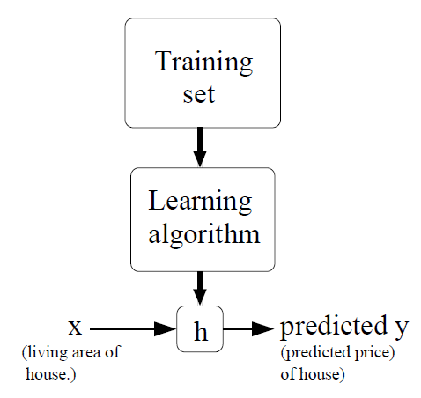
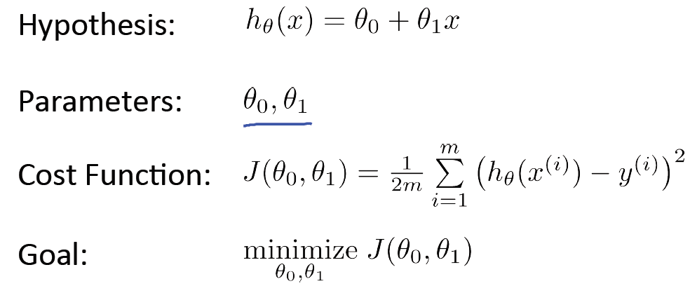
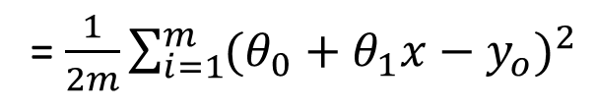
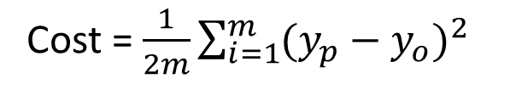
Formal Definition
Our goal is, given a training set, to learn a function h : X → Y so that h(x) is a “good” predictor for the corresponding value of y. For historical reasons, this function h is called a hypothesis.
y_{p} = mx + c
Cost = $\frac{1}{2m}\sum_{i=1}^{m}{{(y_{p}−y_{o})}^{2}}$
Population of location
Profit made by a shop
at that location
= $\frac{1}{2m}\sum_{i=1}^{m}{{(θ_{0}+θ_{1}x−y_{o})}^{2}}$

Slide 14


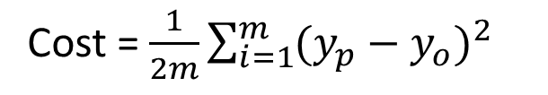
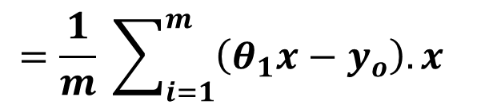
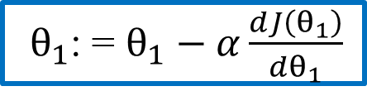
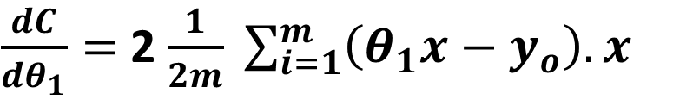




Understanding Gradient Descent
When $θ_{0}$ = 0
C = $\frac{1}{2m} \sum_{i=1}^{m}{{ \left(θ_{1}x−y_{o}\right)}^{2}}$
Cost = $\frac{1}{2m}\sum_{i=1}^{m}{{(y_{p}−y_{o})}^{2}}$
$$\frac{dC}{dθ_{1}}=\frac{1}{2m} \sum_{i=1}^{m}{ \frac{d{\left(θ_{1}x−y_{o}\right)}^{2}}{d(θ_{1}x−y_{o})} . \frac{d(θ_{1}x−y_{o})}{d(θ_{1})}}$$
= $\frac{1}{2m}\sum_{i=1}^{m}{{(θ_{0}+θ_{1}x−y_{o})}^{2}}$
$\frac{dC}{dθ_{1}}=$ 2 $\frac{1}{2m} \sum_{i=1}^{m}{\left(θ_{1}x−y_{o}\right).x}$
$$=\frac{1}{m} \sum_{i=1}^{m}{\left(θ_{1}x−y_{o}\right).x}$$
${ θ}_{1}$: = $θ_{1}−α\frac{dJ\left(θ_{1}\right)}{dθ_{1}}$
$α$=Learning Rate
Cost---->
Cost---->
Cost---->
Cmin
$$θ_{b}$$
$θ_{1}$----->
$$θ_{1}^{a}{ θ}_{1}^{b} θ_{1}^{c}$$
$θ_{1}$----->
$$θ_{1}^{d}{ θ}_{1}^{e} θ_{1}^{f}$$
$θ_{1}$----->

Slide 15




Full Fledge Gradient Descent Algorithm
$${ θ}_{0}$$
$${ θ}_{1}$$

Slide 16

Error Calculation

Slide 17



Concept of Learning Rate
${ θ}_{1}$: = $θ_{1}−α\frac{dJ\left(θ_{1}\right)}{dθ_{1}}$
First Try , $α$ = 0.0001
0.0001 X 3=0.0003 (2nd Try)
0.0003 X 3 ~ 0.001 (3rd Try, & so on)
0.001 X 3= 0.003
0.003 X 3 ~ 0.01

Slide 18










Multivariable Regression
$$Yp=mx+c$$
or, Y$p=θ_{1}x+θ_{0}$
Yp = M₁ X₁ + M₂ X₂ +….+ M_{n} X_{n} + C
$$or, Yp={θ_{0}+θ}_{1}x$$
or, Yp$=θ_{0}.1+θ_{1}.x$
Yp = $θ_{0}$.1+ θ₁ X₁ + θ ₂ X₂ + θ ₃ X₃….+ θ _{n}X_{n}
$Yp$ =
$$\left\lfloor \begin{matrix}1 & x\end{matrix}\right\rfloor$$
*
$$\left\lfloor \begin{matrix}θ_{0} \\ θ_{1}\end{matrix}\right\rfloor$$
Up to n feature
$$\left\lfloor \begin{matrix}θ_{0} \\ \begin{aligned}θ_{1} \\ \text{θ} \text{2} \\ \text{θ} \text{3} \\ . \\ . \\ . \\ \\ \text{θ} \text{n}\end{aligned}\end{matrix}\right\rfloor$$
(n+1,1)
Locations | Size of Flat(feet2) | Number of Bedrooms | Price ($)
0 | 2104 | 3 | 399900
1 | 1600 | 3 | 329900
2 | 2400 | 3 | 369000
3 | 1416 | 2 | 232000
4 | 3000 | 4 | 539900
5 | 1985 | 4 | 299900
6 | 1534 | 3 | 314900
7 | 1427 | 3 | 198999
8 | 1380 | 3 | 212000
9 | 1494 | 3 | 242500
10 | 1940 | 4 | 239999
11 | 2000 | 3 | 347000
12 | 1890 | 3 | 329999
$$\left\lfloor \begin{matrix}1 & \text{X}\text{1} \end{matrix} \text{X}\text{2} \text{X}\text{3}\text{ ... ... }…. \text{X}\text{n}\right\rfloor$$
$y$ =
$$\left\lfloor \begin{matrix}1 & \text{X}\text{1} \end{matrix} \text{X}\text{2} \text{X}\text{3}\text{ ... ... }…. \text{X}\text{n}\right\rfloor ∗$$
$$\left\lfloor \begin{matrix}1 & \text{X}\text{1} \end{matrix} \text{X}\text{2} \text{X}\text{3}\text{ ... ... }…. \text{X}\text{n}\right\rfloor$$
….
Up to m dataset
M X (n+1)
(n+1,1)
Same Grad.D.
will work
Price Size of Flat Number of Bedrooms
Yp = M₁ X₁ + M₂ X₂ + C
Yp = M₁ X₁ + M₂ X₂ +….+ M_{n} X_{n} + C

Slide 19


PREDICTION > MULTIVARIABLE REGRESSION
Locations | Size of Flat(feet2) | Number of Bedrooms | Price ($)
0 | 2104 | 3 | 399900
1 | 1600 | 3 | 329900
2 | 2400 | 3 | 369000
3 | 1416 | 2 | 232000
4 | 3000 | 4 | 539900
5 | 1985 | 4 | 299900
6 | 1534 | 3 | 314900
7 | 1427 | 3 | 198999
8 | 1380 | 3 | 212000
9 | 1494 | 3 | 242500
10 | 1940 | 4 | 239999
11 | 2000 | 3 | 347000
12 | 1890 | 3 | 329999
Price
Locations
- Original - Predicted
Price Size of Flat Number of Bedrooms
Price
Yp = M₁ X₁ + M₂ X₂ + C
Yp = M₁ X₁ + M₂ X₂ +….+ M_{n} X_{n} + C
Locations

Slide 20


Understanding Contour Plot

Slide 21


Skewed Data-Set and Standardization
Contour plot of skewed data Cost fn.
Gradient Descent has tough time to reach at minima.
It may take too long
or, it may diverge completely.
►
►
►
Standardization:
Each feature is transformed by Subtracting
its own Mean and Dividing by its own Standard Deviation.

Slide 22



Polynomial Regression
Third Degree Polynomial Feature Transformation
Second Degree Polynomial Feature Transformation
From the plot, it is seen that there is no linear
relationship between X and Y.
Now, instead of using ‘X ‘ as input features, We will use f1,f2,f3,… as features for modeling .
So it becomes simply a multivariable regression problem.

Slide 23
THANK YOU !!
Reference: http://cs229.stanford.edu/
www.linkedin.com/in/ramendra-kumar-57334478

